Slide 1
Unit-5
Spring Framework

Slide 2
Spring Framework
Open-Source Framework
Standalone and Enterprise application can be developed
Released in 2003(initial), 2004(production) developed by Rod Johnson

Slide 3
Advantages
Modular and lightweight(lightweight and easy to maintain applications)
Flexible configuration(supports Java-based, XML-based and annotation-based configurations)
Dependency Injection(dependency management)
Aspect oriented programming(Allows developers to separate code from the features like logging, transactions, security etc.)
Easy database handling(reduce boilerplate code increase efficiency)
Testing support
Security(robust framework for implementing authentication, authorization)
High integration capabilities(with other frameworks and technologies like angular, react, JMS, SOAP, REST)
High Scalability
Open-Source

Slide 4
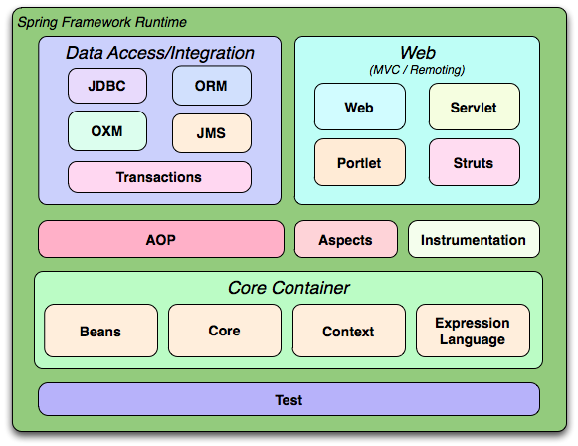
Modules
The Spring Framework consists of features organized into about 20 modules. These modules are grouped into Core Container, Data Access/Integration, Web, AOP (Aspect Oriented Programming), Instrumentation, and Test, as shown in the following diagram.

Slide 5
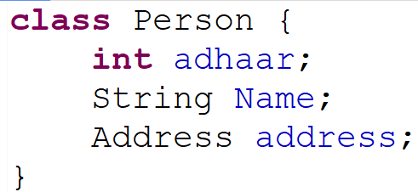
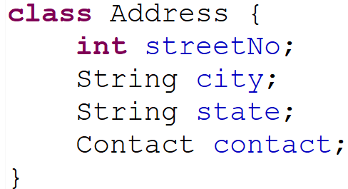
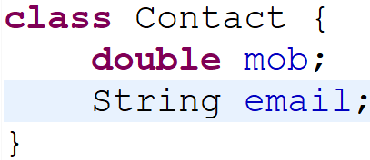
Dependency?
Example of dependency
Code has very high degree of coupling due to aggregation
To create Object of class Person, we depend on Address Object, and to create Address object, we need contact

Slide 6
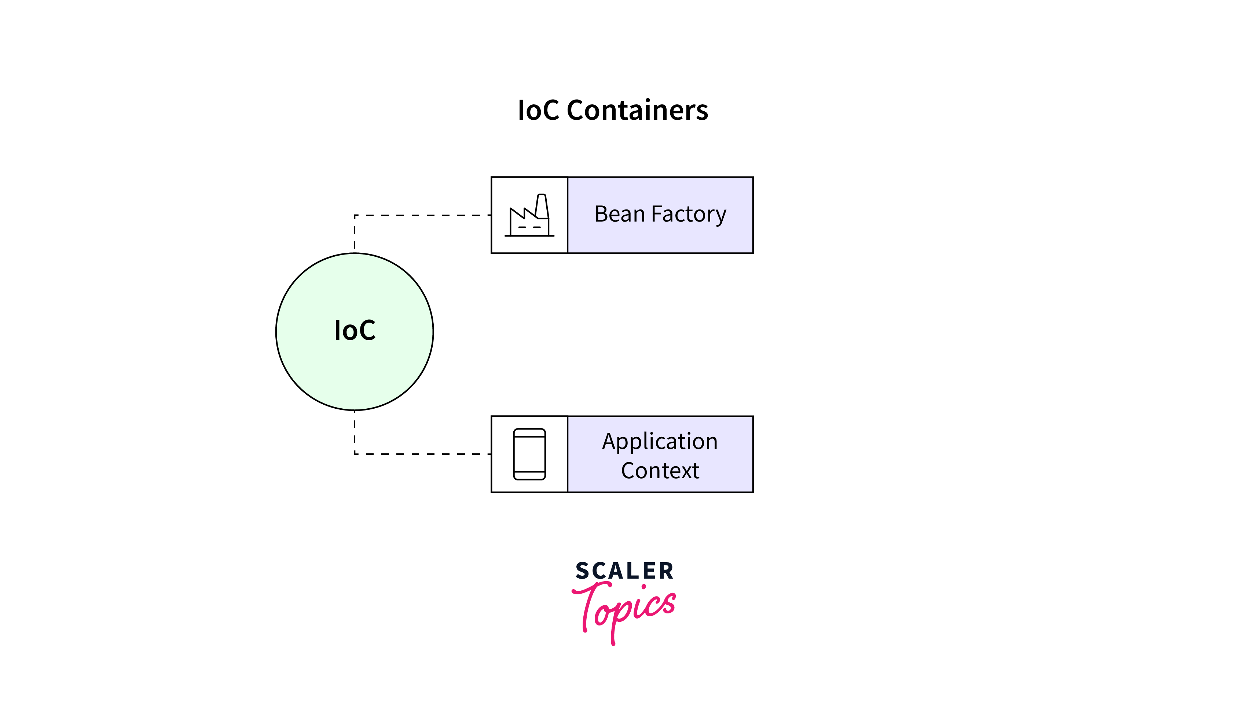
Spring Container
The Spring container is the core of the Spring Framework.
Manages Bean Objects(create, initialize, destroy)[Life cycle of bean]
It is responsible for creating, configuring, and managing the objects that make up your application.
The container uses a technique called dependency injection to manage the relationships between objects.
Transaction Management
Spring container are of TWO TYPES
BeanFactory(old Method)
ApplicationContext(new Method)

Slide 7
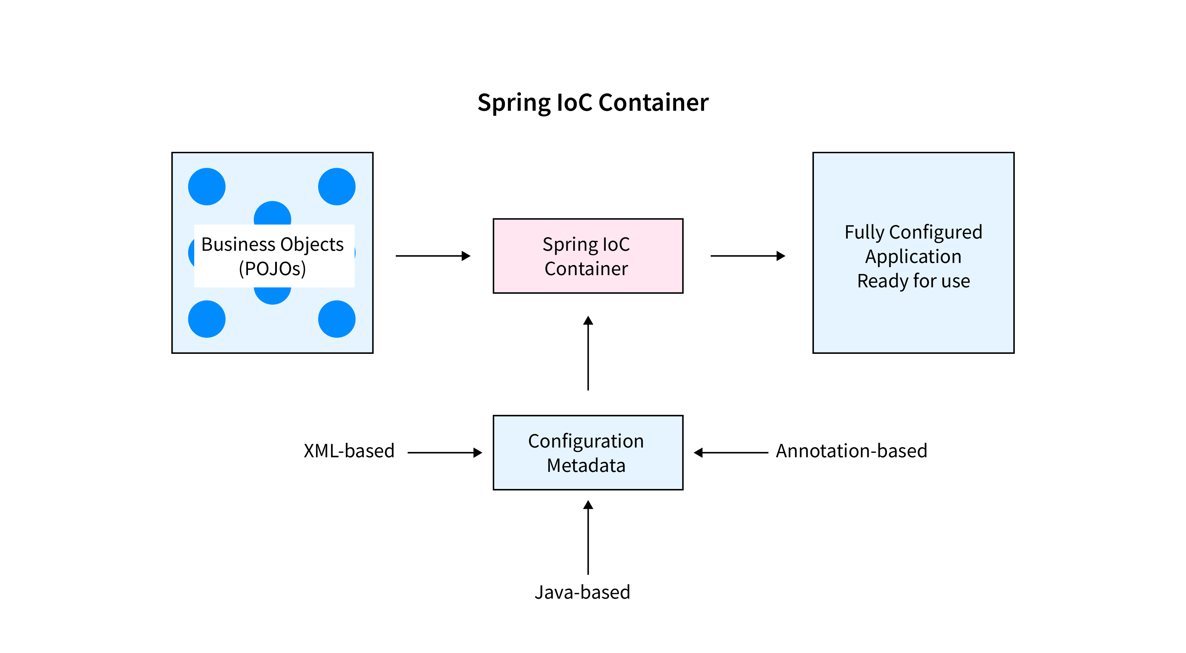
Working of Spring Container

Slide 8
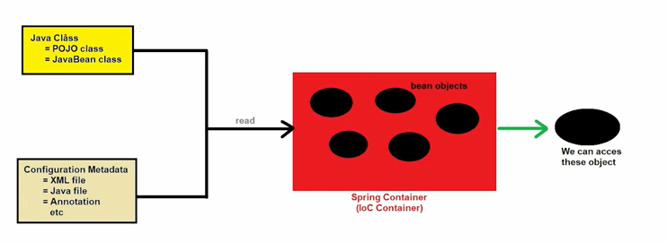
Working of Spring Container

Slide 9
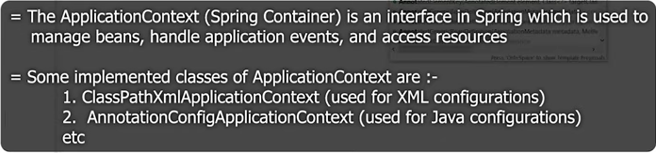
Working of Spring Container

Slide 10
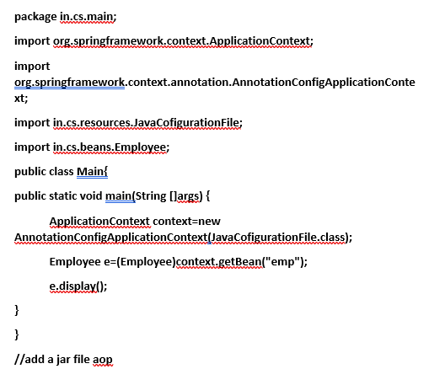
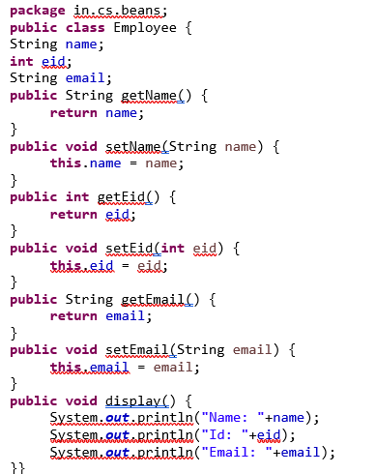
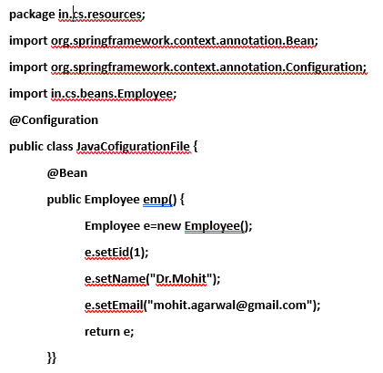
Spring Framework Example with Java Configuration file

Slide 11
Inversion of Control (IoC)
Inversion of Control (IoC) is a design principle that emphasizes keeping Java classes independent of each other.
IoC is achieved through Dependency Injection (DI).
IoC refers to transferring the control of objects and their dependencies from the main program to a container or framework.
The IoC container uses two primary mechanisms to work:
Bean instantiation:
The IoC container is responsible for creating and configuring beans. This can be done through XML configuration, Java annotations, or a combination of both.
Dependency injection:
The IoC container injects dependencies into beans. This means that the IoC container is responsible for providing beans with the objects they need to function.

Slide 12
Spring Dependency Injection
Dependency Injection (DI) is a design pattern that allows you to decouple your code by making it easier to create and manage objects.
In Spring, DI is implemented using the Inversion of Control (IoC) container. The IoC container is responsible for creating and managing objects, and it injects them into your code when needed.
Dependency Injection is a fundamental aspect of the Spring framework, through which the Spring container “injects” objects into other objects or “dependencies”.
There are two types of Spring Dependency Injection.
Setter Dependency Injection (SDI)
Constructor Dependency Injection (CDI)

Slide 13
Spring IoC (Inversion of Control) | Spring Dependency Injection
Spring IoC Container is the core of Spring Framework. It creates the objects, configures and assembles their dependencies, manages their entire life cycle. | Spring Dependency injection is a way to inject the dependency of a framework component by the following ways of spring: Constructor Injection and Setter Injection
Spring helps in creating objects, managing objects, configurations, etc. because of IoC (Inversion of Control). | Spring framework helps in the creation of loosely-coupled applications because of Dependency Injection.
Spring IoC is achieved through Dependency Injection. | Dependency Injection is the method of providing the dependencies and Inversion of Control is the end result of Dependency Injection.
IoC is a design principle where the control flow of the program is inverted. | Dependency Injection is one of the subtypes of the IOC principle.
Aspect-Oriented Programming, Dependency look up are other ways to implement Inversion of Control. | In case of any changes in business requirements, no code change is required.

Slide 14
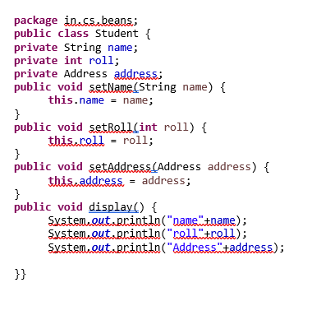
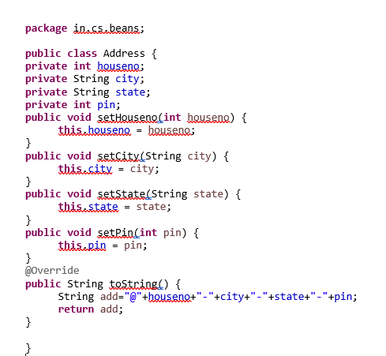
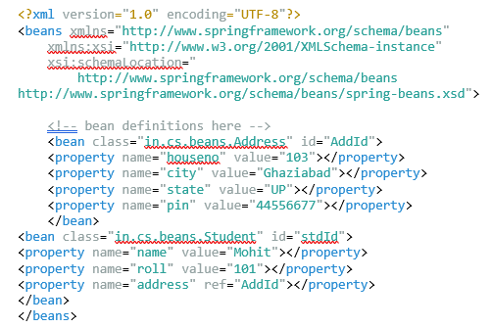
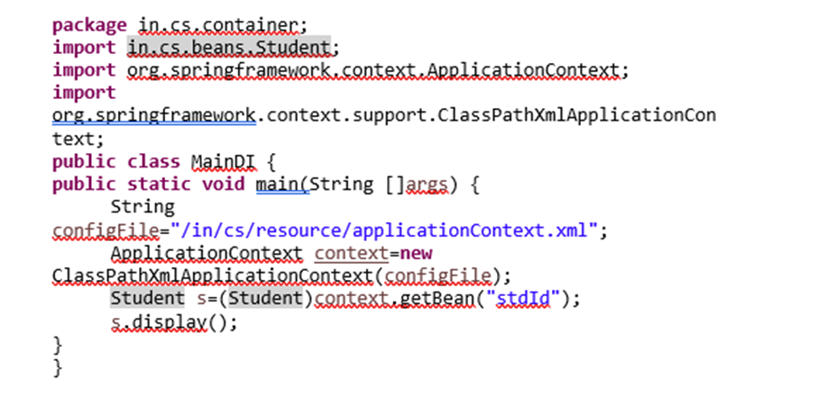
Dependency Injection using Setter Method

Slide 15
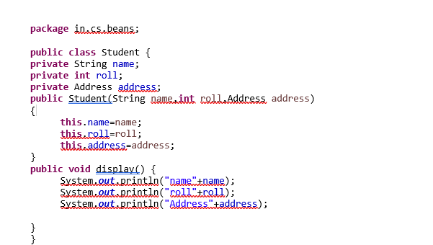
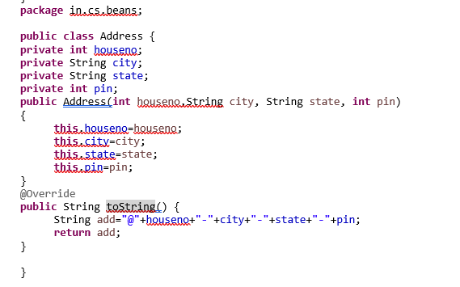
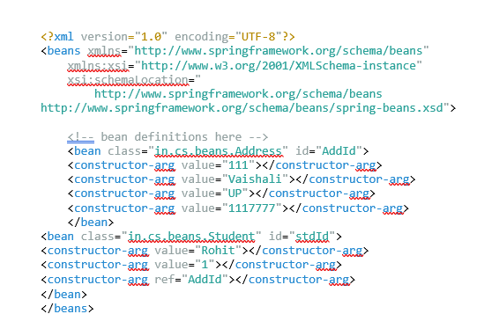

// Dependecy Injection Using Constructor

Slide 16
Setter Method DI | Constructor DI
Dependencies are injected into class through setter methods | Dependencies are injected into a class through constructor
More readable | Less readable
More Flexible | Less Flexible

Slide 17
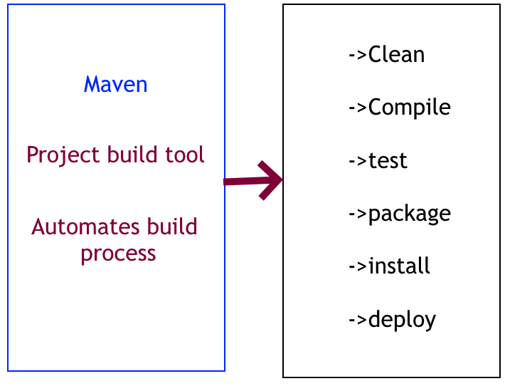

Slide 18
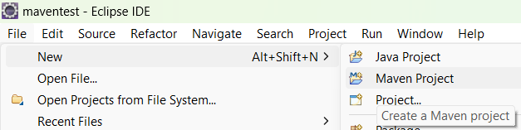
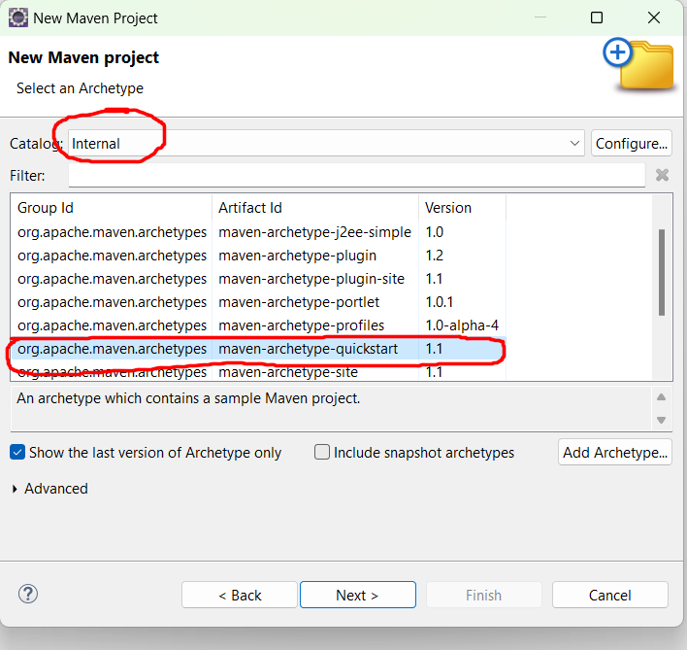
1. Create Maven project
2. Select Catlog and archtype as
marked

Slide 19
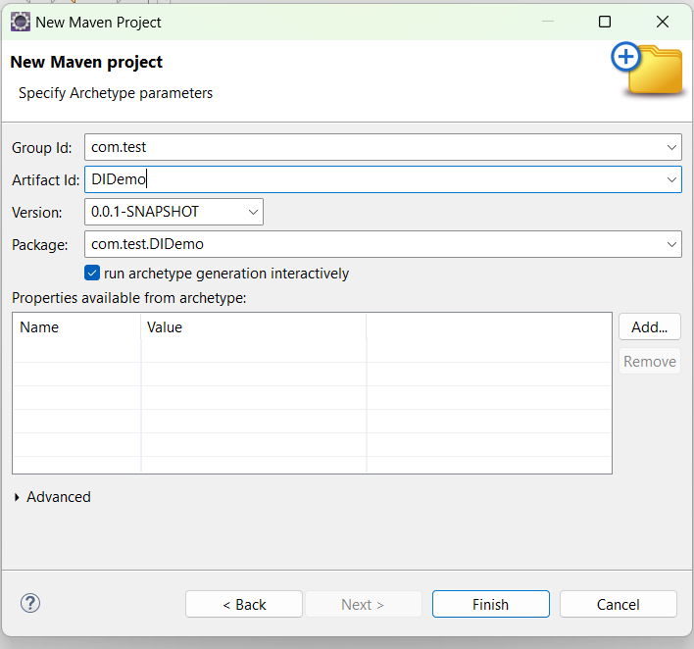
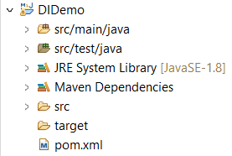
3. Provide group id and artifact Id
4. Press finish
*(Internet must be on)
5. Open pom.xml(project object model)

Slide 20
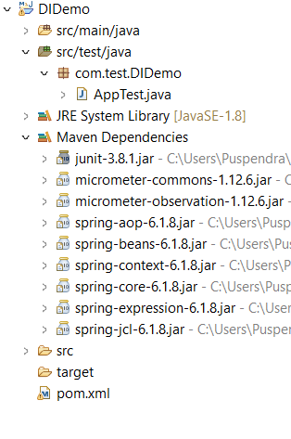
6. Add dependencies to <dependencies> tag
Press crtl+s to save the pom.xml file(all dependencies will be downloaded automatically)
<dependency>
<groupId>org.springframework</groupId>
<artifactId>spring-core</artifactId>
<version>6.1.8</version>
</dependency>
<dependency>
<groupId>org.springframework</groupId>
<artifactId>spring-context</artifactId>
<version>6.1.8</version>
</dependency>
7. Check Project structure

Slide 21
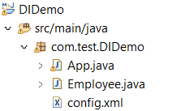
package com.test.DIDemo;
public class Employee {
//POJO CLASS:FULLY E NCASULATED CLASS
private int empId;
private String name;
private String dept;
public Employee(int empId, String name, String dept) {
super();
this.empId = empId;
this.name = name;
this.dept = dept;
}
public int getEmpId() {
return empId;
}
public void setEmpId(int empId) {
this.empId = empId;
}
public String getName() {
return name;
}
public void setName(String name) {
this.name = name;
}
public String getDept() {
return dept;
}
public void setDept(String dept) {
this.dept = dept;
}
}
8. Create new class Employee
9. Create new xml file
<?xml version="1.0" encoding="UTF-8"?>
<beans xmlns="http://www.springframework.org/schema/beans"
xmlns:xsi="http://www.w3.org/2001/XMLSchema-instance"
xsi:schemaLocation="
http://www.springframework.org/schema/beans http://www.springframework.org/schema/beans/spring-beans.xsd">
<bean class="com.test.DIDemo.Employee" name="stud1">
<property name="id" value="1" />
<property name="name" value="Raju" />
<property name="dept" value="Sales" />
</bean>
</beans>
10. See project structure now

Slide 22
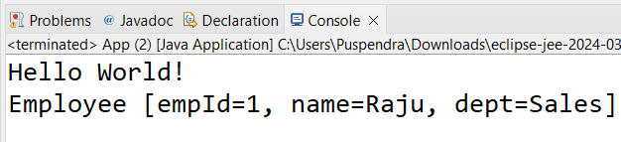
9. Update App.java
package com.test.DIDemo;
import org.springframework.context.ApplicationContext;
import org.springframework.context.support.ClassPathXmlApplicationContext;
public class App
{
public static void main( String[] args )
{
System.out.println( "Hello World!" );
ApplicationContext context=new ClassPathXmlApplicationContext("com/test/DIDemo/config.xml");
Employee employee=(Employee)context.getBean("stud1");
System.out.println(employee);
}
}
Dependency injection
10.
execute App.java

Slide 23
Aspect-Oriented Programming (AOP)
Aspect-Oriented Programming (AOP) is a programming technique that allows developers to modularize cross-cutting concerns. Cross-cutting concerns are tasks that affect multiple parts of a program, such as logging, security, and transaction management.
AOP allows developers to separate these concerns from the main program logic. This makes the code more modular, reusable, and maintainable.
Spring AOP is a popular implementation of AOP. It provides a simple and powerful way to write custom aspects.
Spring provides simple and powerful ways of writing custom aspects by using either a schema-based approach or the @AspectJ annotation style. Both of these styles offer fully typed advice and use of the AspectJ pointcut language while still using Spring AOP for weaving.
AOP is used in the Spring Framework to:
Provide declarative enterprise services. The most important such service is declarative transaction management.
Let users implement custom aspects, complementing their use of OOP with AOP.

Slide 24
Benefits of using AOP
Modularity:
AOP allows developers to separate cross-cutting concerns from the main program logic. This makes the code more modular, reusable, and maintainable.
Reusability:
Aspects can be reused across multiple projects. This saves time and effort, and it can help to improve the consistency of code.
Maintainability:
AOP makes it easier to maintain code. This is because cross-cutting concerns are separated from the main program logic. This makes it easier to understand and modify the code.

Slide 25
WebSocket API
Spring Framework provides a WebSocket API that adapts to various WebSocket engines, including Tomcat, Jetty, GlassFish, WebLogic, and Undertow. This API allows developers to easily implement WebSocket-based applications. The Spring Framework also provides a number of features that make it easy to develop WebSocket-based applications, including:
A messaging framework that supports STOMP, a text-oriented messaging protocol that can be used over any reliable 2-way streaming network protocol such as TCP and WebSocket.
A JavaScript client library that makes it easy to develop WebSocket-based web applications.
A number of pre-built WebSocket-based applications, such as a chat application and a stock ticker.

Slide 26
BEAN SCOPE
Bean Scopes refers to the lifecycle of Bean that means when the object of Bean will be instantiated, how long does that object live, and how many objects will be created for that bean throughout. Basically, it controls the instance creation of the bean and it is managed by the spring container.
In the Spring Framework, a bean's scope determines how long it lives and how many instances of it are created.
The default scope is singleton, Only one instance will be created for a single bean definition per Spring IoC container and the same object will be shared for each request made for that bean.
The prototype scope A new instance will be created for a single bean definition every time a request is made for that bean. This is useful for beans that are not thread-safe or that need to be customized for each request.
The request scope creates a new instance of the bean for each HTTP request. This is useful for beans that need to be associated with a specific request, such as a database connection or a shopping cart.
The session scope creates a new instance of the bean for each user session. This is useful for beans that need to be associated with a specific user, such as a user profile or a shopping cart.
The global session scope creates a new instance of the bean for each user session across all applications in the same cluster. This is useful for beans that need to be shared across multiple applications, such as a user profile or a shopping cart.

Slide 27
BEAN SCOPE
You can specify the scope of a bean using the @Scope annotation. For example, the following code creates a bean with the prototype scope:
@Scope("prototype")
public class MyBean {
// ...
}
OR
<bean class="com.test.DIDemo.Employee" name="stud1" scope="request">
<property…
</bean>

Slide 28
Autowiring
Autowiring in the Spring framework can inject dependencies automatically.
The Spring container detects those dependencies specified in the configuration file and the relationship between the beans.This is referred to as Autowiring in Spring.
Autowiring in Spring internally uses constructor injection.
An autowired application requires fewer lines of code comparatively but at the same time, it provides very little flexibility to the programmer.

Slide 29
Modes | Description
No | This mode tells the framework that autowiring is not supposed to be done. It is the default mode used by Spring.
byName | It uses the name of the bean for injecting dependencies.
byType | It injects the dependency according to the type of bean.
Constructor | It injects the required dependencies by invoking the constructor.
Autodetect(deprecated in Spring 3) | The autodetect mode uses two other modes for autowiring – constructor and byType.
1. No
This mode tells the framework that autowiring is not supposed to be done. It is the default mode used by Spring.

Slide 30
2. byName
It uses the name of the bean for injecting dependencies. However, it requires that the name of the property and bean must be the same. It invokes the setter method internally for autowiring.
<bean id="state" class=“pack.State">
<property name="name" value="UP" />
</bean>
<bean id="city" class=“pack.City" autowire="byName"></bean>
3. byType
It injects the dependency according to the type of the bean. It looks up in the configuration file for the class type of the property. If it finds a bean that matches, it injects the property. If not, the program throws an error. The names of the property and bean can be different in this case. It invokes the setter method internally for autowiring.
<bean id="state" class="sample.State">
<property name="name" value="UP" />
</bean>
<bean id="city" class="sample.City" autowire="byType"></bean>

Slide 31
4. constructor
It injects the required dependencies by invoking the constructor. It works similar to the “byType” mode but it looks for the class type of the constructor arguments. If none or more than one bean are detected, then it throws an error, otherwise, it autowires the “byType” on all constructor arguments.
<bean id="state" class="sample.State">
<property name="name" value="UP" />
</bean>
<bean id="city" class="sample.City" autowire="constructor"></bean>
5. autodetect
The autodetect mode uses two other modes for autowiring – constructor and byType. It first tries to autowire via the constructor mode and if it fails, it uses the byType mode for autowiring. It works in Spring 2.0 and 2.5 but is deprecated from Spring 3.0 onwards.
<bean id="state" class="sample.State">
<property name="name" value="UP" />
</bean>
<bean id="city" class="sample.City" autowire="autodetect"></bean>

Slide 32
class City {
private int id;
private String name;
private State s;
public City() {
}
public int getID() { return id; }
public void setId(int eid) { this.id = eid; }
public String getName() { return name; }
public void setName(String st) { this.name = st; }
public State getS() {
return s;
}
public void setS(State s) {
this.s = s;
}
public int getId() {
return id;
}
public City(State s) {
super();
this.s = s;
}
public City(int id, String name, State s) {
super();
this.id = id;
this.name = name;
this.s = s;
}
@Override
public String toString() {
return "City [id=" + id + ", name=" + name + ", s=" + s + "]";
}
}
package com.test.DemoProject;
import org.springframework.beans.factory.annotation.Autowired;
public class State {
private String name;
public String getName() { return name; }
public void setName(String s) { this.name = s; }
@Override
public String toString() {
return "State [name=" + name + "]";
}
public State(String name) {
super();
this.name = name;
}
public State() {
super();}
}
Auto wiring example
dependency
//main
package com.test.DemoProject;
import org.springframework.context.ApplicationContext;
import org.springframework.context.support.ClassPathXmlApplicationContext;
public class Test {
public static void main(String[] args) {
ApplicationContext context = new ClassPathXmlApplicationContext("/com/test/DemoProject/config1.xml");
City city=context.getBean("city", City.class);
System.out.println(city);
}
}

Slide 33
<?xml version="1.0" encoding="UTF-8"?>
<beans xmlns="http://www.springframework.org/schema/beans"
xmlns:xsi="http://www.w3.org/2001/XMLSchema-instance"
xmlns:p="http://www.springframework.org/schema/p"
xmlns:context="http://www.springframework.org/schema/context"
xsi:schemaLocation="http://www.springframework.org/schema/beans
http://www.springframework.org/schema/beans/spring-beans.xsd
http://www.springframework.org/schema/context
http://www.springframework.org/schema/context/spring-context.xsd">
<bean id="s" class="com.test.DemoProject.State" >
<property name="name" value="UP" />
</bean>
<bean name="city" class="com.test.DemoProject.City" autowire="constructor">
<property name="id" value="11" />
<property name="name" value="Washington, D.C." />
</bean>
</beans>
<?xml version="1.0" encoding="UTF-8"?>
<beans xmlns="http://www.springframework.org/schema/beans"
xmlns:xsi="http://www.w3.org/2001/XMLSchema-instance"
xmlns:p="http://www.springframework.org/schema/p"
xmlns:context="http://www.springframework.org/schema/context"
xsi:schemaLocation="http://www.springframework.org/schema/beans
http://www.springframework.org/schema/beans/spring-beans.xsd
http://www.springframework.org/schema/context
http://www.springframework.org/schema/context/spring-context.xsd">
<bean id="s" class="com.test.DemoProject.State" >
<property name="name" value="UP" />
</bean>
<bean name="city" class="com.test.DemoProject.City" autowire="byName">
<property name="id" value="11" />
<property name="name" value="Washington, D.C." />
</bean>
</beans>

Slide 34
@autowired
There are three ways to apply the @Autowired annotation:
NOTE: PUT FOLLOWING LINE IN CONFIG.XML FILE
<context:annotation-config/>
1. On a field: This is the most common way to use the @Autowired annotation. Simply annotate the field with @Autowired and Spring will inject an instance of the dependency into the field when the bean is created.
public class MyBean {
@Autowired
private MyDependency dependency;
}
2. On a constructor: You can also use the @Autowired annotation on a constructor. This will cause Spring to inject an instance of the dependency into the constructor when the bean is created.
public class MyBean {
private MyDependency dependency;
@Autowired
public MyBean(MyDependency dependency) {
this.dependency = dependency;
}
}

Slide 35
3. On a setter method: You can also use the @Autowired annotation on a setter method. This will cause Spring to inject an instance of the dependency into the setter method when the bean is created.
public class MyBean {
private MyDependency dependency;
@Autowired
public void setDependency(MyDependency dependency) {
this.dependency = dependency;
}
}
The @Autowired annotation can be used on any field, constructor, or setter method that is declared in a Spring bean. The dependency that is injected must be a Spring bean itself.

Slide 36
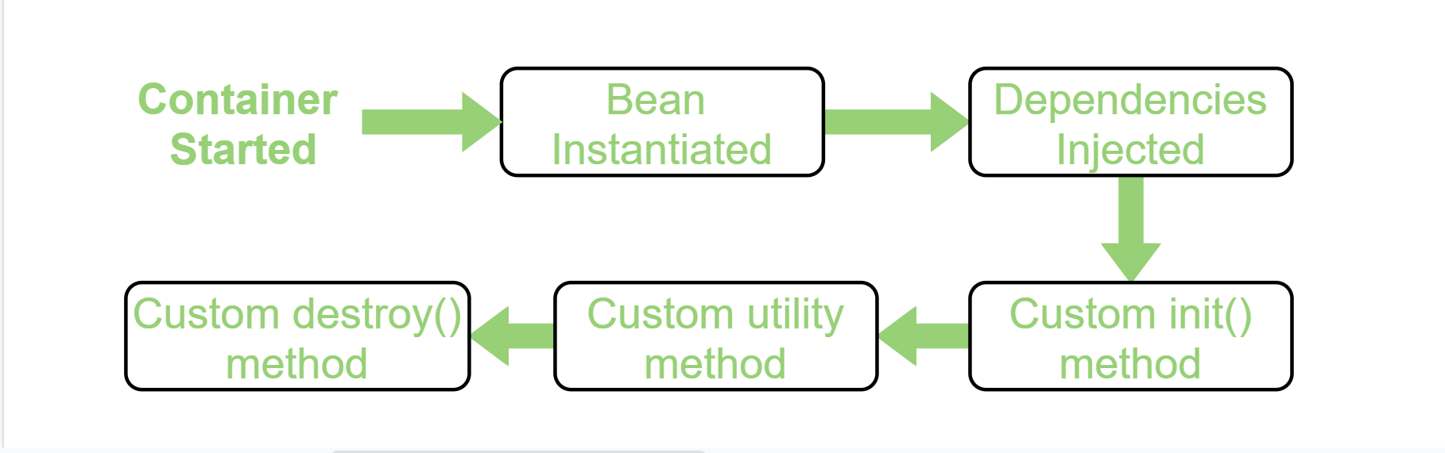
Life Cycle Call backs
Bean life cycle is managed by the spring container. When we run the program then, first of all, the spring container gets started. After that, the container creates the instance of a bean as per the request, and then dependencies are injected. And finally, the bean is destroyed when the spring container is closed. Therefore, if we want to execute some code on the bean instantiation and just after closing the spring container, then we can write that code inside the custom init() method and the destroy() method.

Slide 37
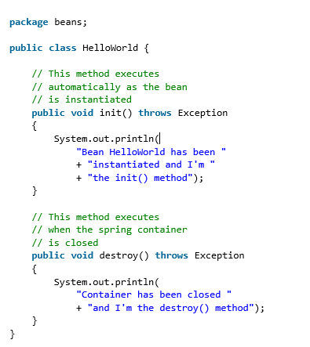
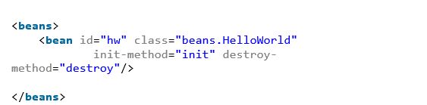
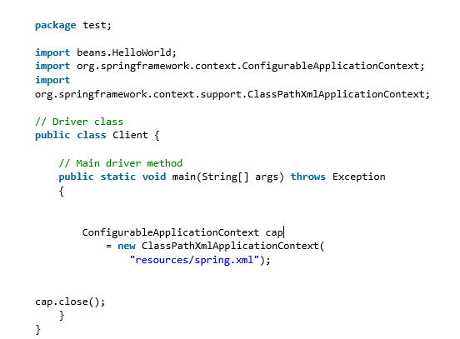
Example: Life Cycle Call Back

